Slide 1

EXAKT 80E PLUS
Password software
For Software since November 2017
Martin Sussiek / November 2017

Slide 2
Preparation
Before your start

Slide 3
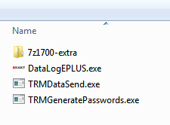
Setup & Requirements
The software is tested for Windows 7 and 10
  There is no installation required, double-click the EXE-file to start the program
  It is necessary to have the “7z-1700-extra” directory in the same directory as the EXE

Slide 4
Change User Passwords
EXAKT 80E PLUS

Slide 5
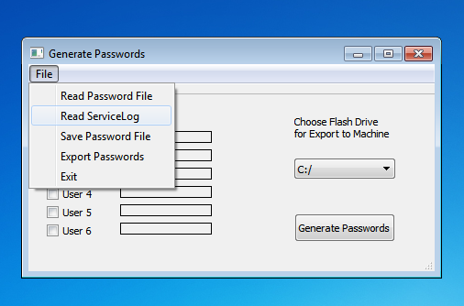
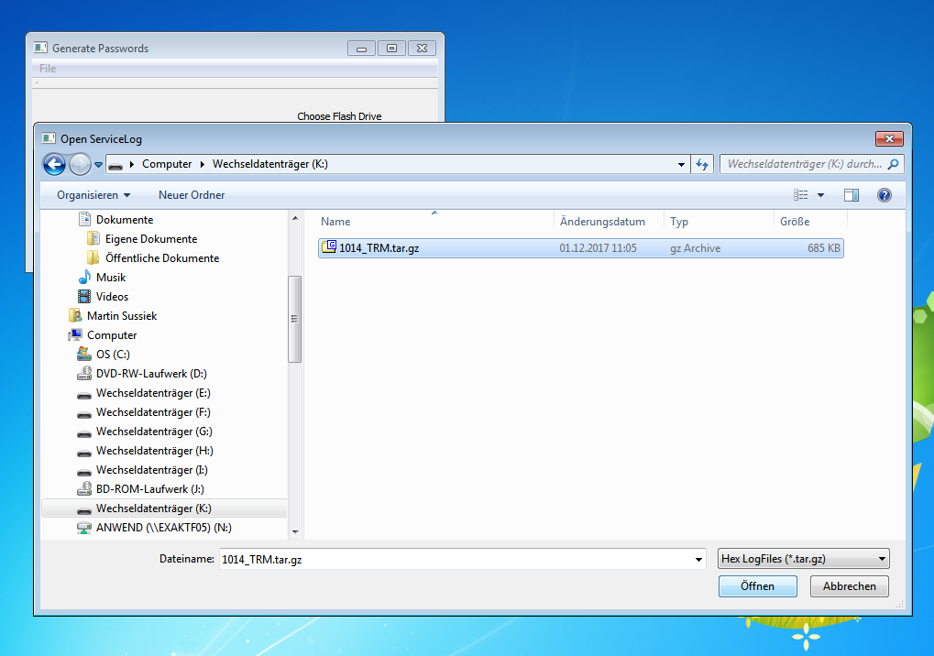
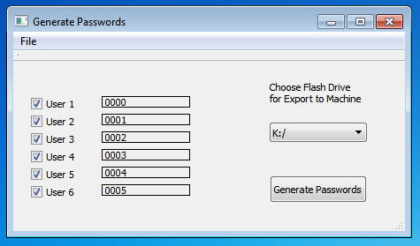
Load Passwords from the machine
Save a ServiceLog on USB flash drive
  Insert flash drive in PC
  Start TRMGeneratePassword.exe
  Go to File/Read ServiceLog and choose the ServiceLog
  (e.g. 1014_TRM.tar.gz)
  Confirm both message windows
  The actual user passwords will be displayed

Slide 6
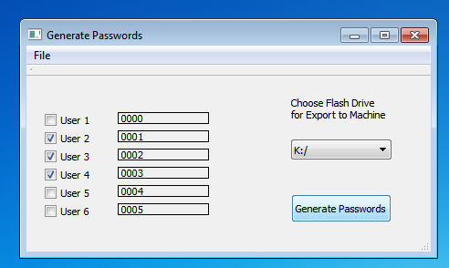
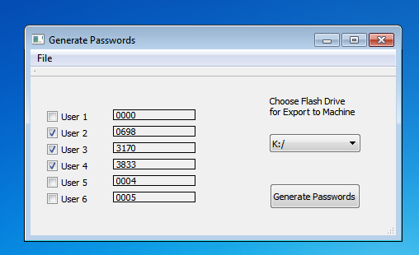
Generate new Passwords
User rights:
    Normal users: User 1 to User 5
    Supervisor: User 6
  Check mark only on Users a new password is required
  Press “Generate Passwords” button
  New passwords will be generated

Slide 7
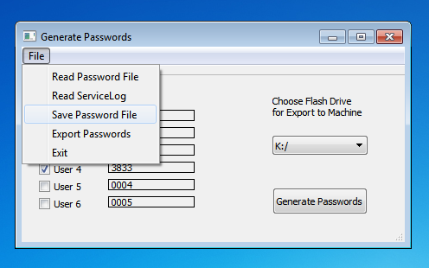
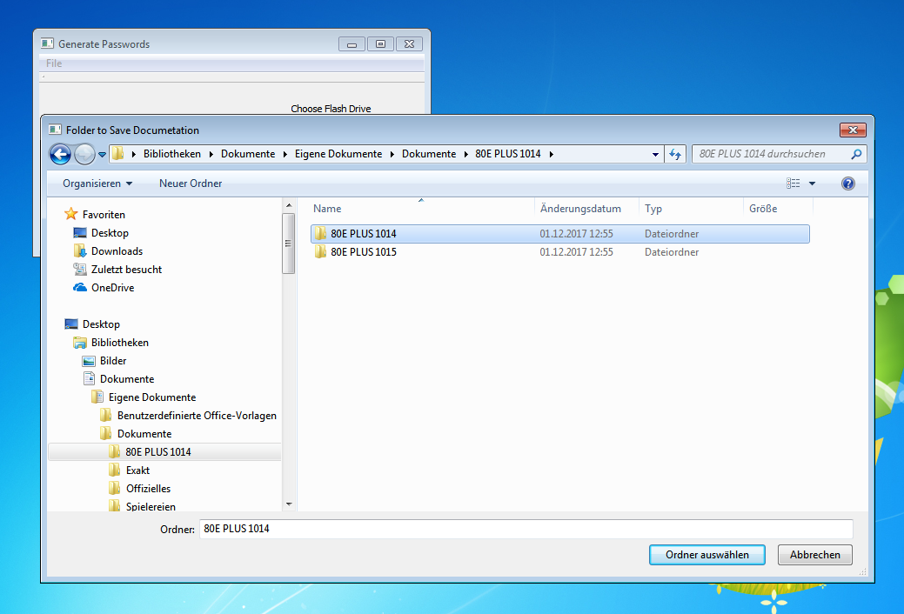
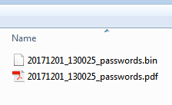
Archive passwords on PC
Go to File/Save Password File
Choose an adequate directory
A PDF with a list of the passwords and the password file with time stamp will be stored:

Slide 8
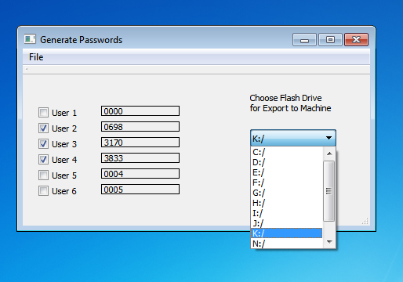
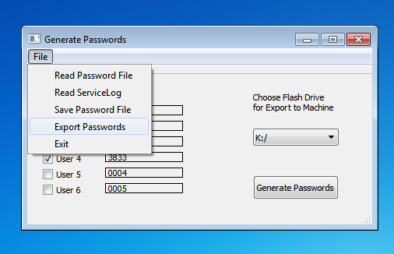
Transfer passwords to Machine
Delete any “autostart” directories on the flash drive
Go to the drop down menu to choose the USB flash drive (default is flash drive with the ServiceLog)
Go to File/Export Passwords
  Confirm message window
  Remove flash drive and insert in Controller of machine
  The new passwords will be transferred automatically and the controller unit will restart

Slide 9
Restore archived passwords

Slide 10
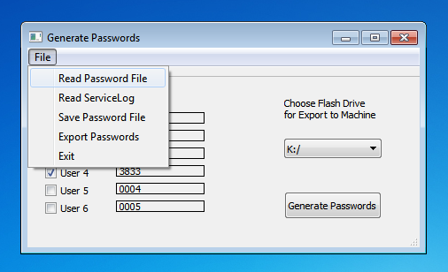
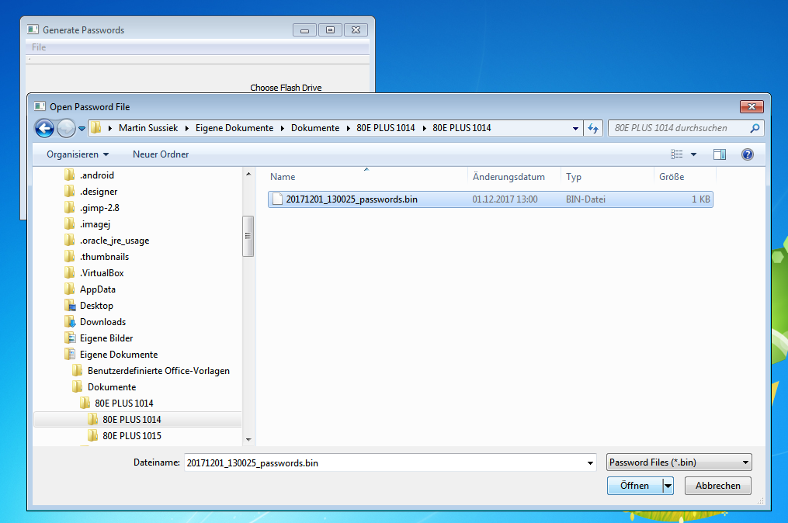
Load archived password file
Go to File/Read Password File
Choose archived File
  The archived passwords will be displayed
  Insert flash drive to PC and delete any “autostart” directory on the flash drive
  To export to machine the same procedure applies as described in “Transfer Passwords to machine”

Slide 11
EXAKT
Advanced Technologies GmbH
Robert-Koch-Straße 5
D-22851 Norderstedt / Germany
T +49 (0)40.52 95 60-0
F +49 (0)40.5 24 99 59 info@exakt.de · www.exakt.de
VIELEN DANK FÜR IHRE AUFMERKSAMKEIT
THANK YOU FOR YOUR ATTENTION

